Slide 1
status_update
9-11
Javier_Napoles
Notes:
This week, I focused on improving my SOC monitoring skills, practicing GitHub workflows, and enhancing professional writing through a cover letter exercise.

Slide 2
Weekly Summary (Sept 8–11, 2025):
Completed a cover letter exercise to improve professional writing skills.
Practiced Pull Requests on GitHub: set up repo, committed changes, opened, reviewed, and merged a PR.
Configured SSH brute force alert rules in Grafana and validated alerts to Discord.
Documented the triage workflow and linked detection evidence for incident response.
Gained experience in collaborative workflows, version control, and SOC monitoring.
Notes:
This week I learned how to integrate Grafana with Wazuh and Discord to build a complete monitoring workflow. I created alert rules, visualized attacks on the dashboard, and confirmed that notifications were sent in real time to a Discord channel. I also practiced Pull Requests on GitHub, setting up a repository, committing changes, and successfully opening, reviewing, and merging a PR. Additionally, I completed a cover letter exercise to improve my professional writing skills, reinforcing both technical and collaborative workflows.

Slide 3
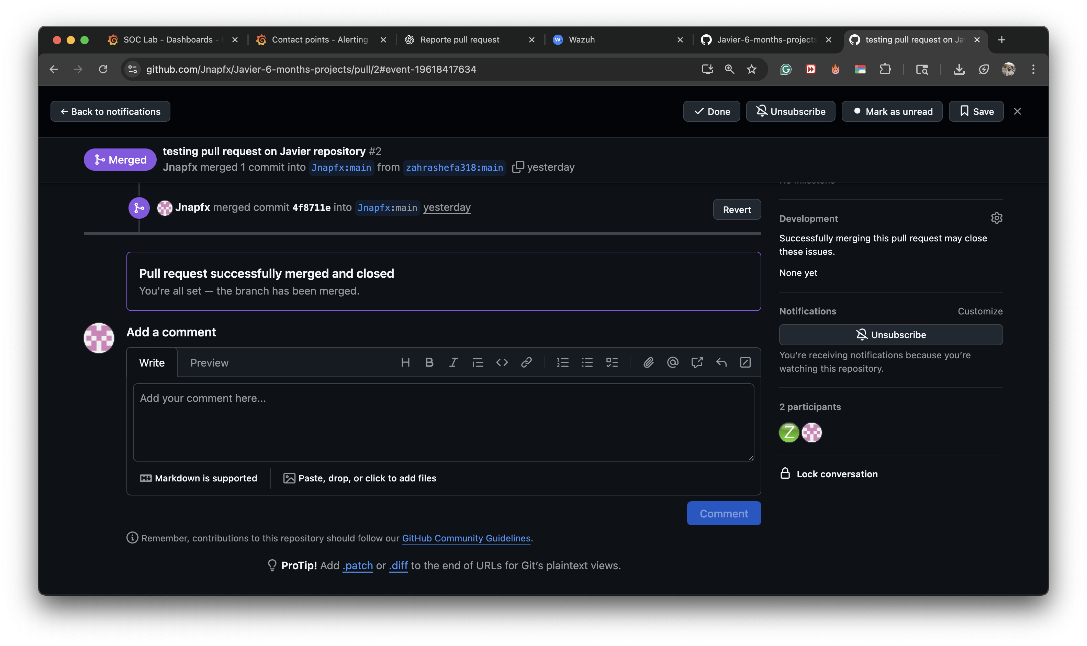

Slide 4
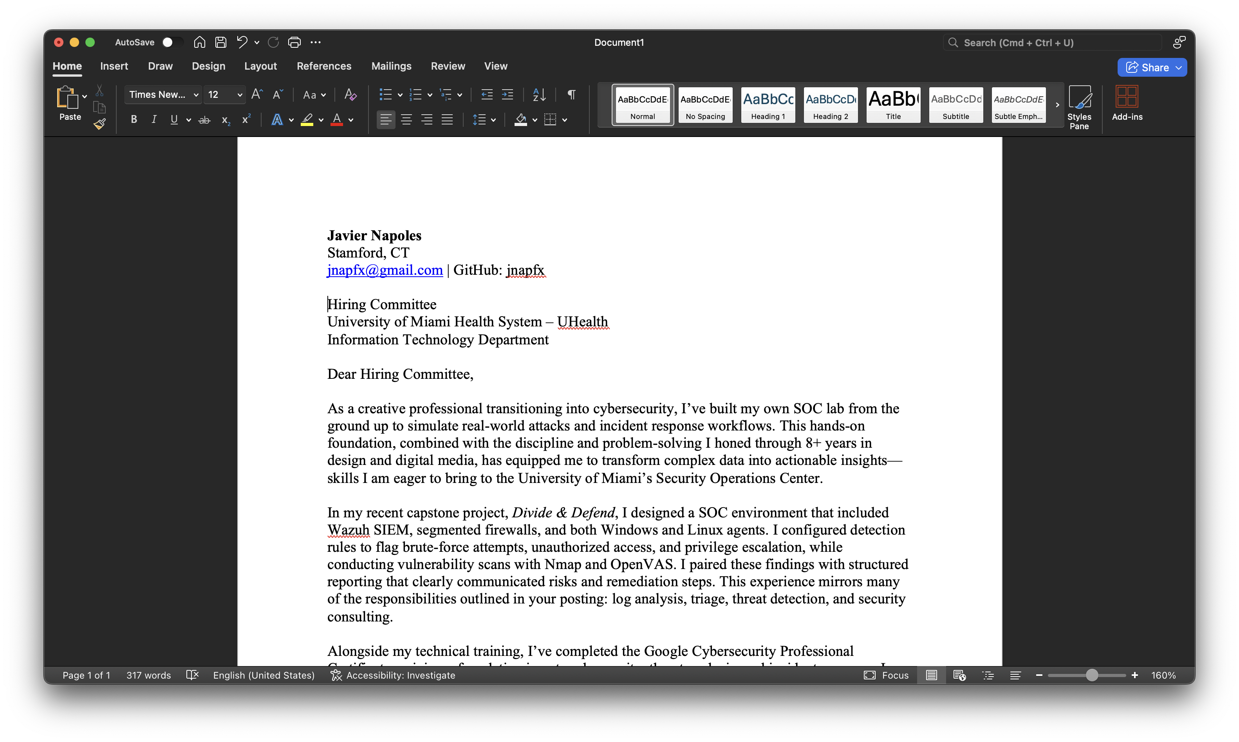
Notes:
COVER LETTER PROMPT ENGEENEER

Slide 5
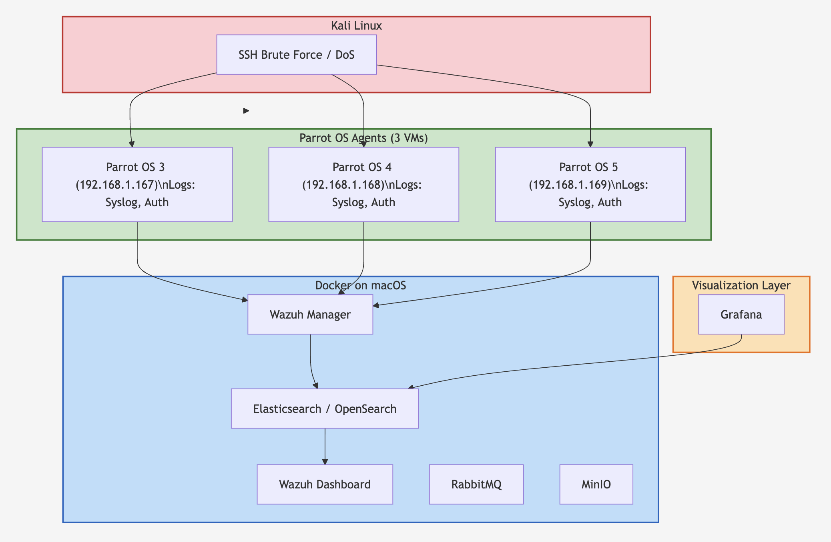
Notes:
This diagram shows our Wazuh home lab.
It’s a hands-on SOC environment where attacks (from Kali) are detected, processed, and visualized by Wazuh and Grafana, reproducing the workflow of a real Security Operations Center.

Slide 6
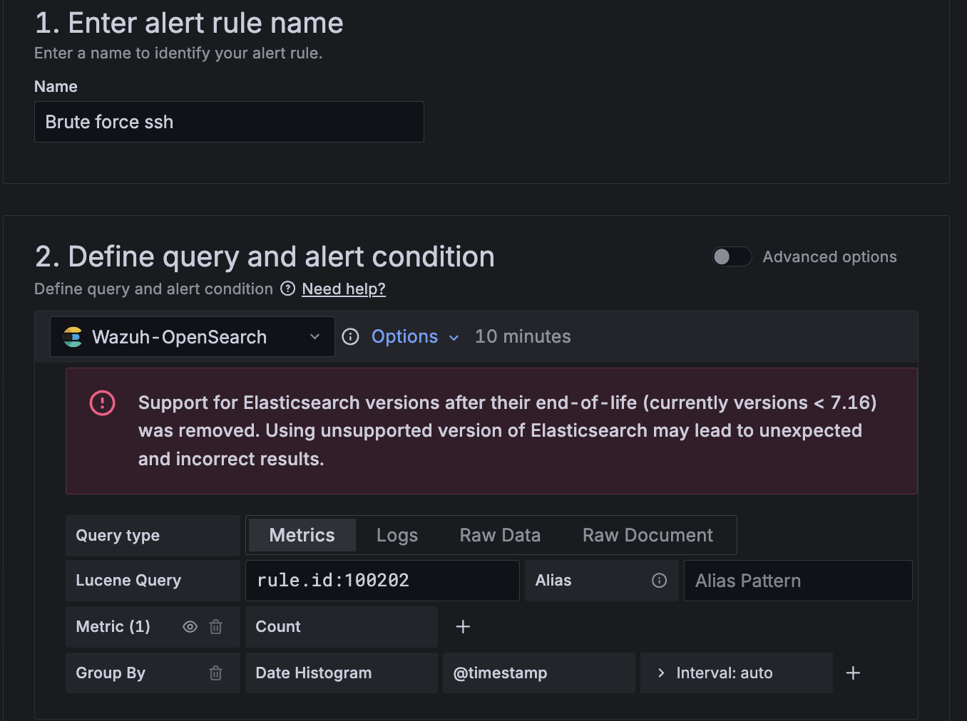
Notes:
Configuring an Alert in Grafana I created a custom alert rule called Brute force ssh. Using the Wazuh-OpenSearch data source, I defined a query (rule.id:100202) that detects SSH brute-force attempts. The alert counts events over time and triggers when suspicious activity is detected.

Slide 7
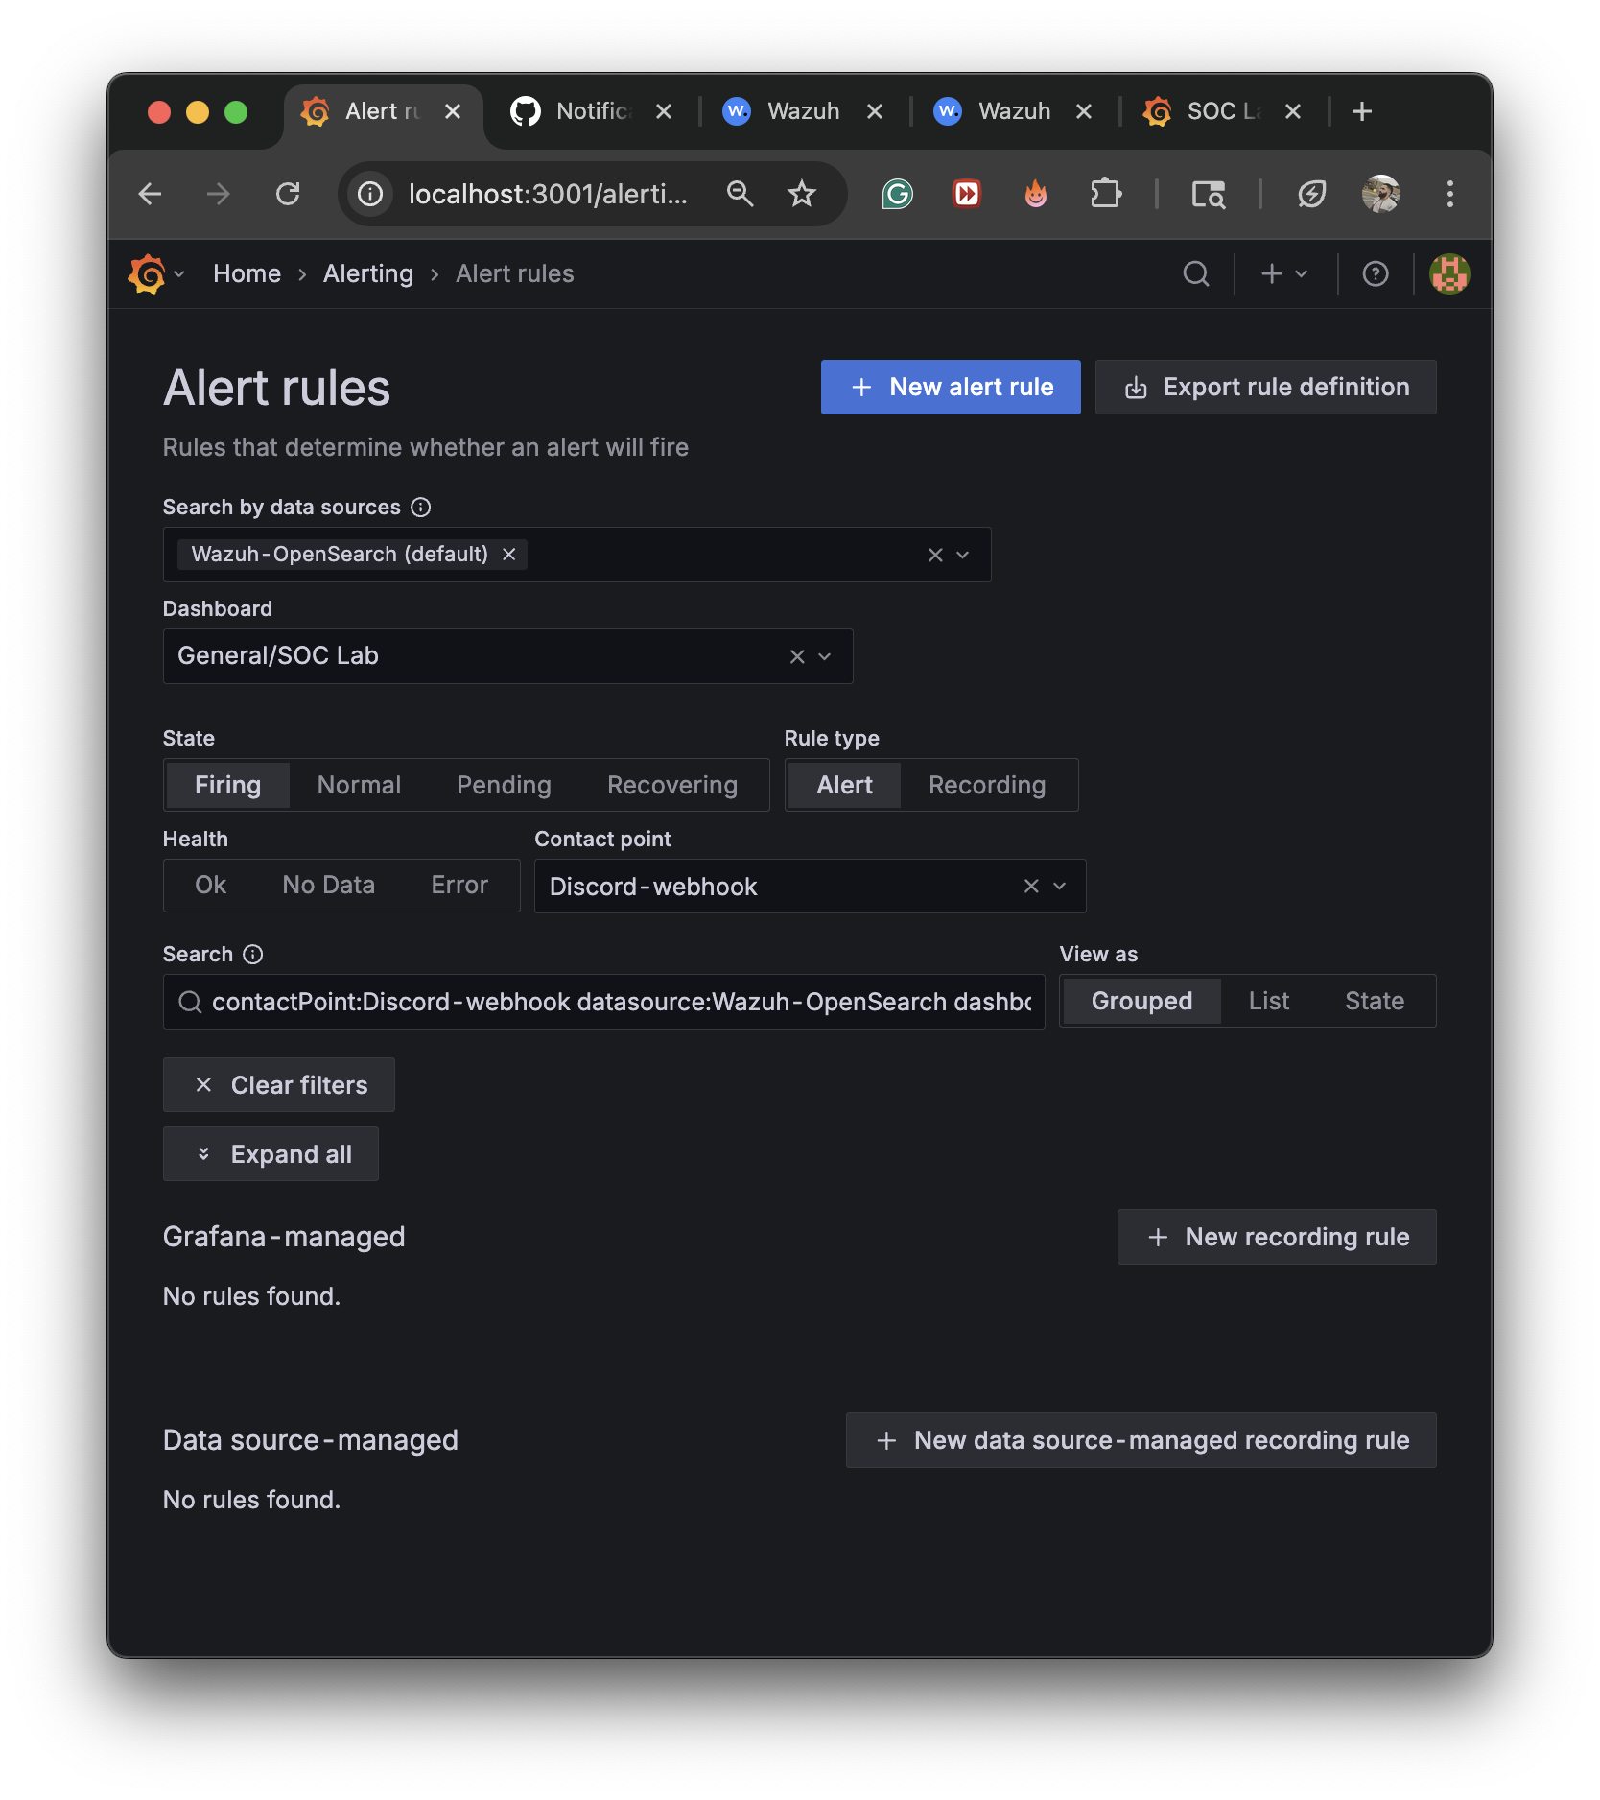
Notes:
Managing Alert Rules in Grafana From the SOC Lab dashboard, I configured alert rules connected to the Wazuh-OpenSearch data source. Alerts are set to trigger when conditions are met and are routed through a Discord webhook, allowing real-time notifications in my channel.

Slide 8
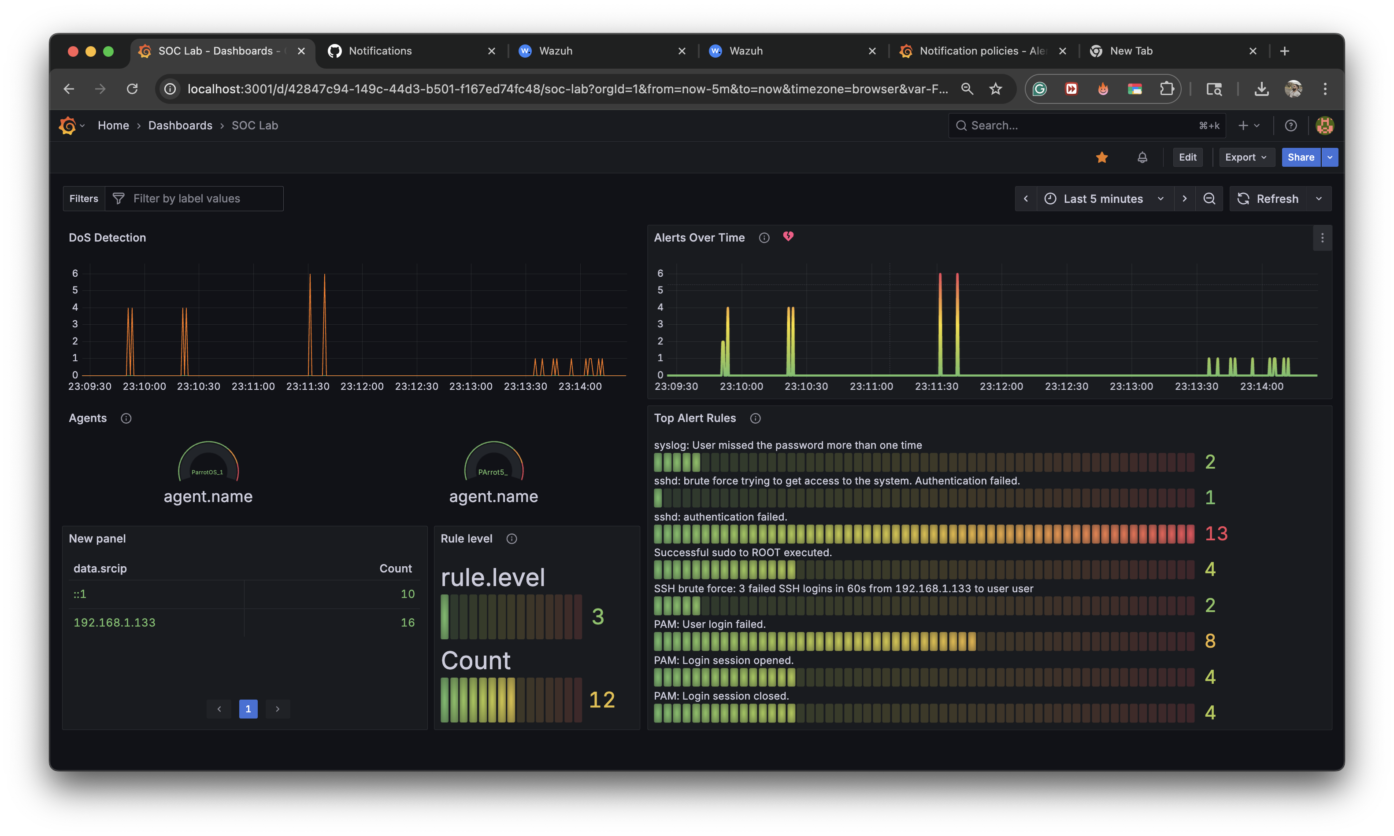
Notes:
SOC Lab Dashboard – Attack Detection The dashboard visualizes alerts in real time. It shows DoS detection trends, active agents, and top alert rules such as failed logins and SSH brute-force attempts. The heatmap highlights the frequency and severity of security events across the monitored system.

Slide 9
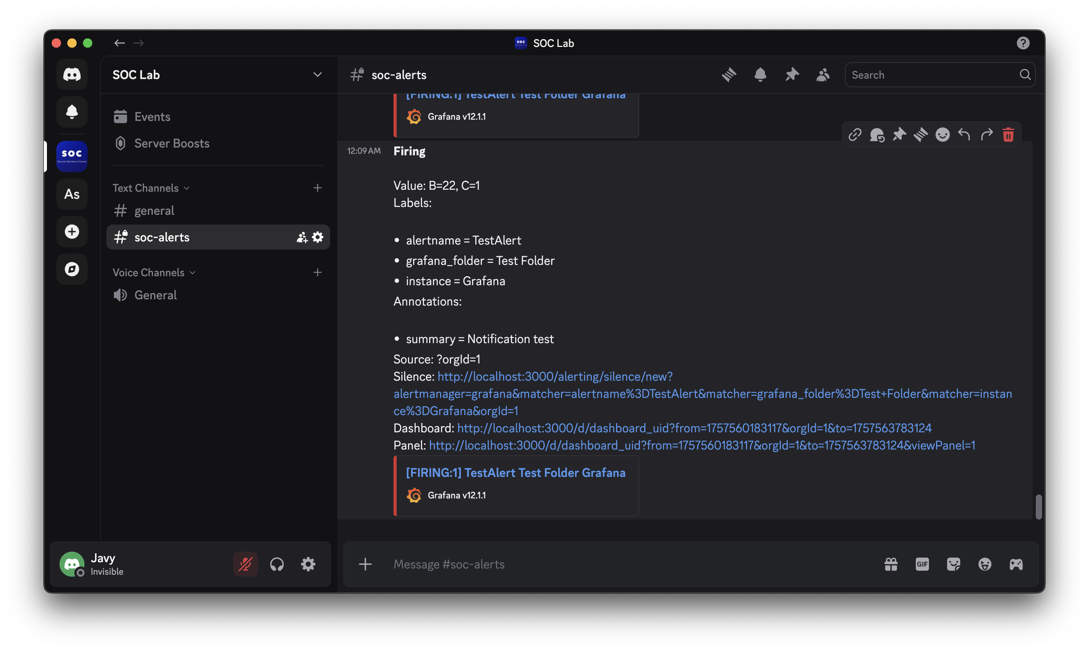
Notes:
Discord Alert Notification Grafana was successfully integrated with Discord. When an alert fires, it is automatically sent to the #soc-alerts channel, showing the rule name, labels, and a direct link back to the Grafana dashboard for investigation.

Slide 10
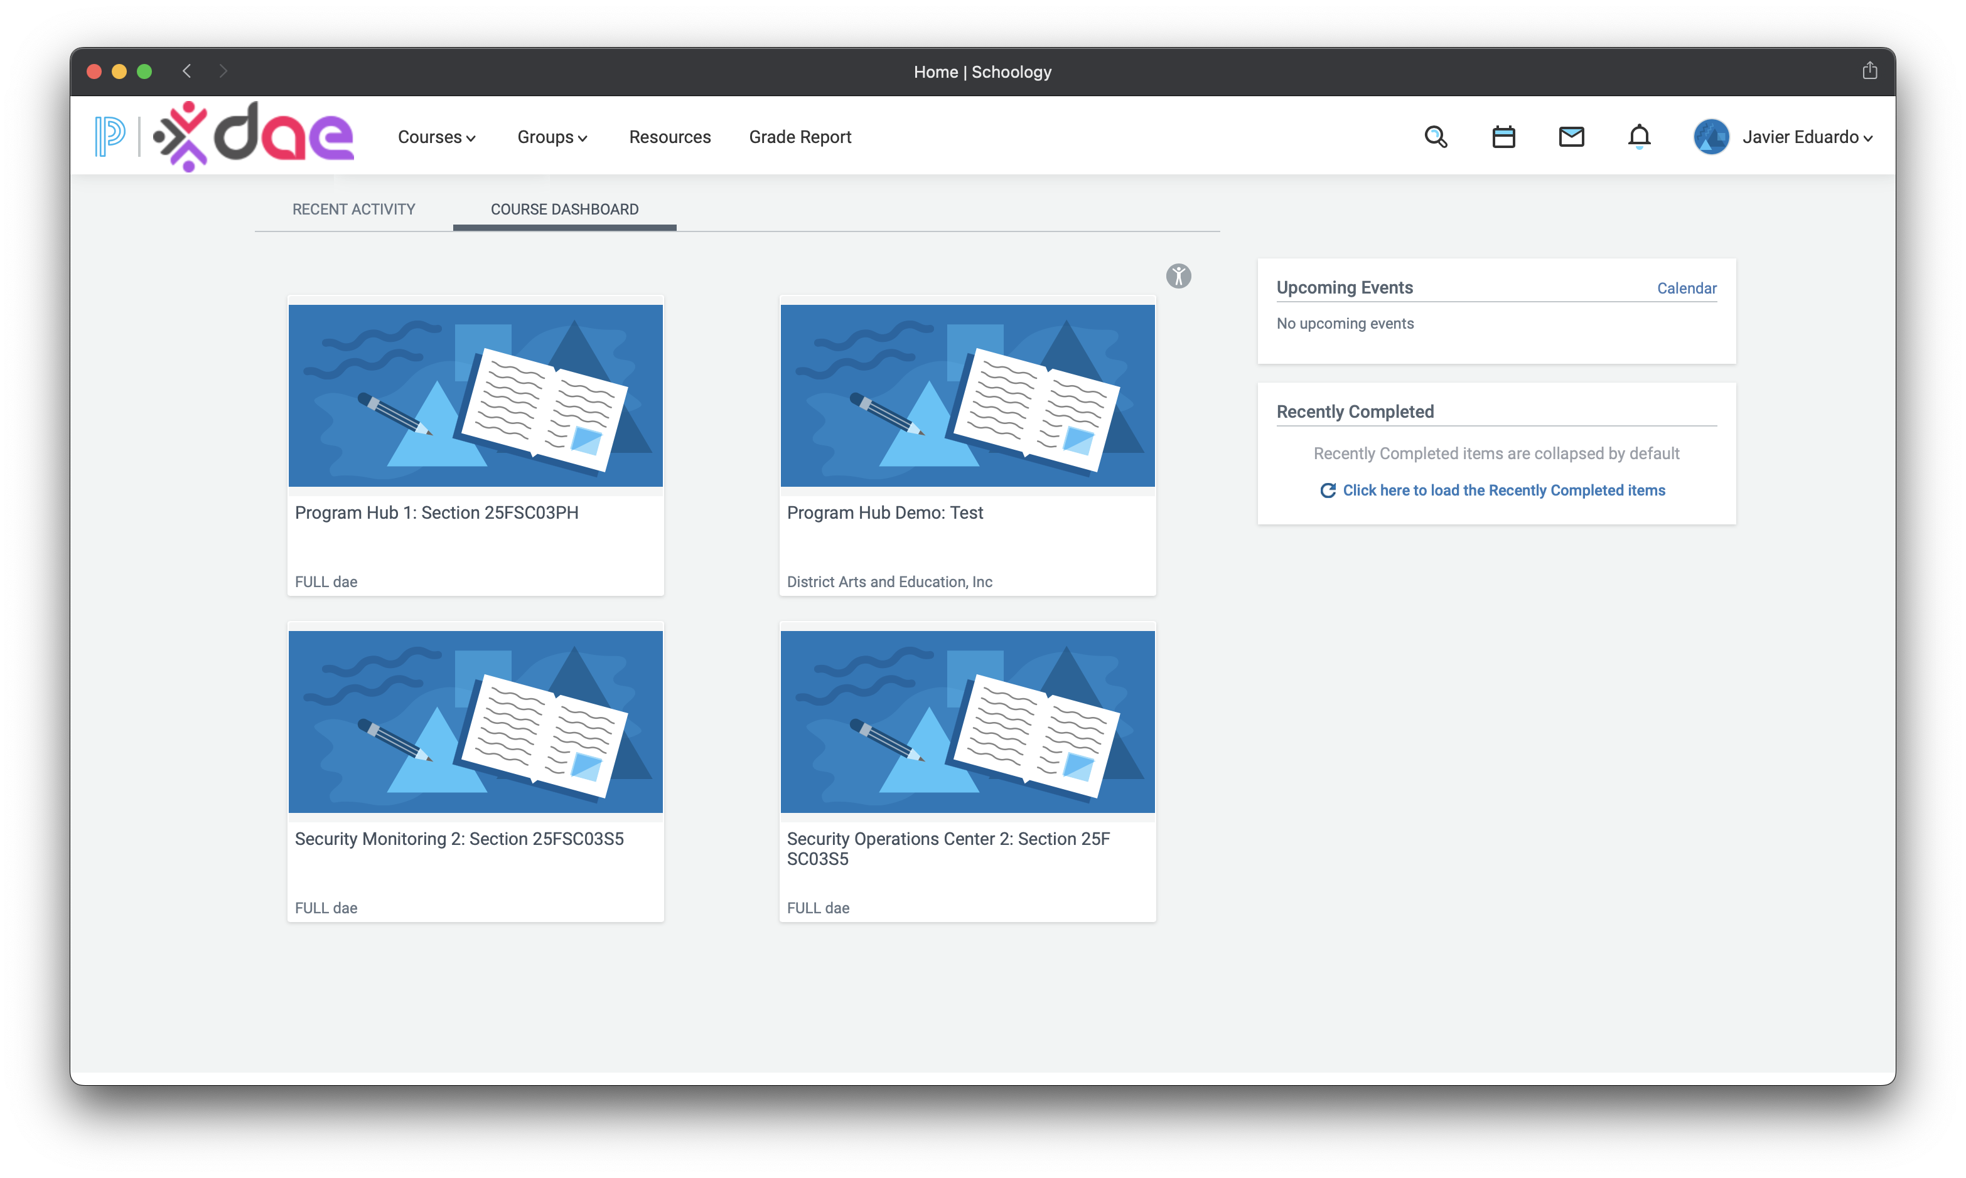
Notes:
Regarding DAE courses, I was able to finish them all.

Slide 11
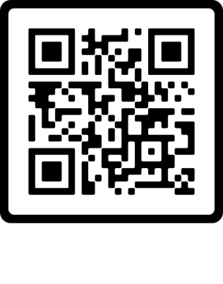
Thank You
Javier Napoles | jnapfx@gmail.com

